Slide 1
How to clear your browser cache:
Internet Explorer 7
Internet Explorer 8
Safari 4 & 5
Firefox 7

Slide 5
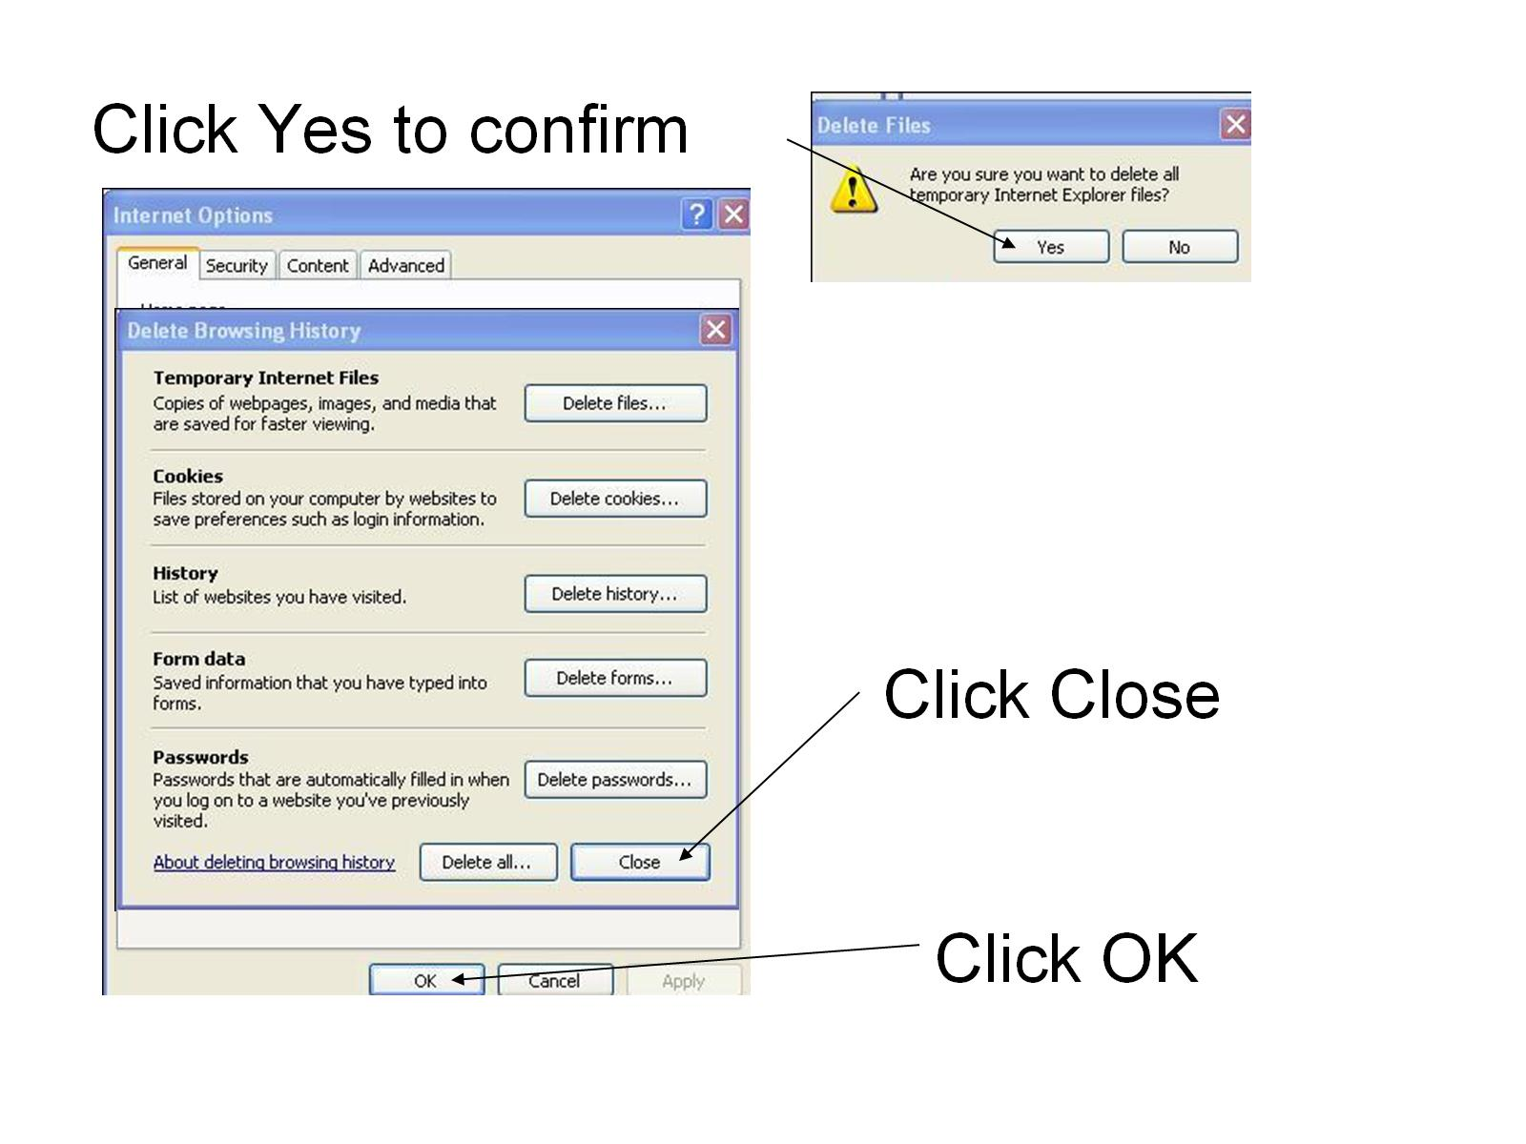

Slide 6
Exit slideshow

Slide 7
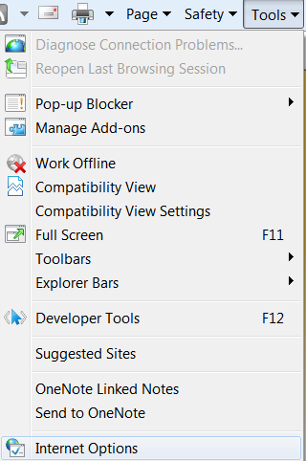
Internet Explorer 8
In the Internet Explorer Menu Bar:
Select Tools
Select Internet Options

Slide 8
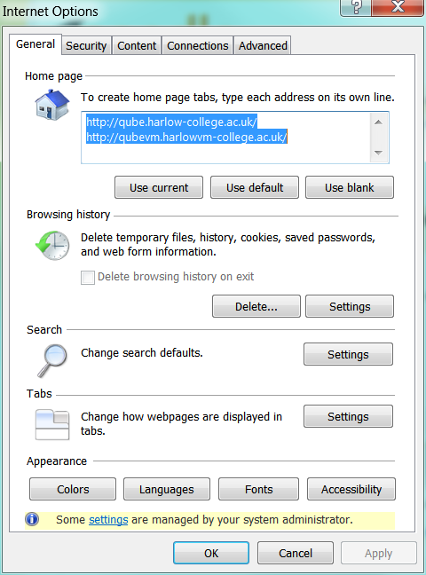
In the General tab, under Browsing history, click Delete…

Slide 9
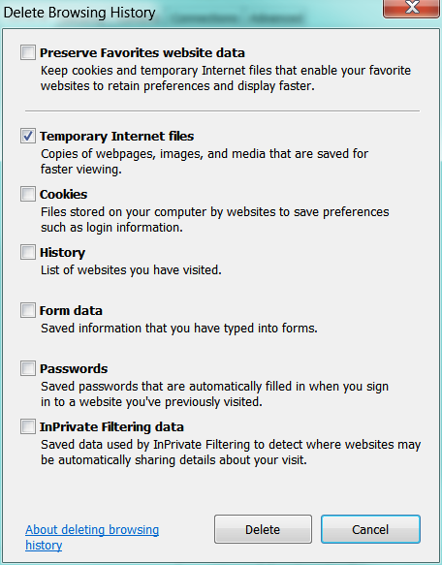
UNCHECK Preserve Favorites website data
CHECK Temporary Internet files
Then click Delete

Slide 10
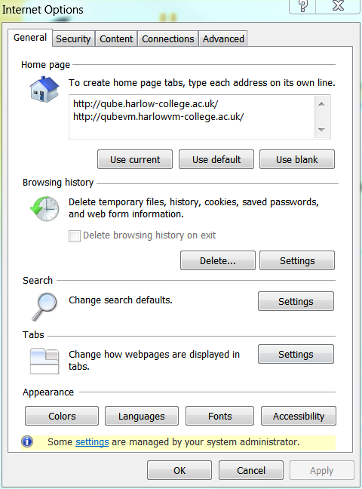
Click OK

Slide 11
Click the Refresh button or press F5
The Internet Explorer browser cache has
now been cleared
Exit slideshow

Slide 12
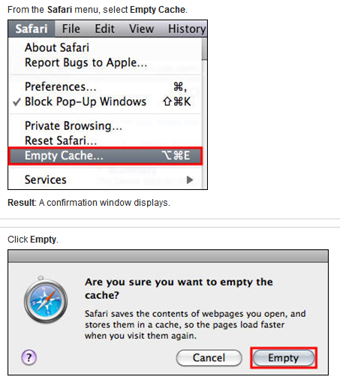
Safari v4 & v5
Click Reload (or press F5)
The Safari browser cache has now been cleared
Exit slideshow

Slide 13
Click the arrow next to Firefox Click Options

Slide 14
On the Network tab: Click Clear Now, then OK

Slide 15
Click Refresh (or press F5)
Click
or press F5
Your Firefox browser cache has now been cleared
Exit slideshow

